Slide 1

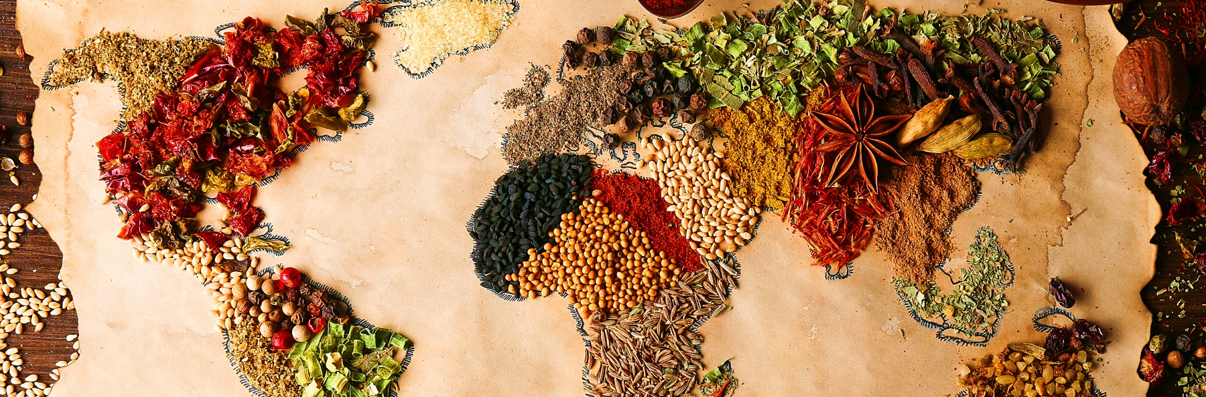


Cuisine Classification
By: Ijeoma N. Akamnonu
February 18, 2021

Slide 2

Summary
Natural Language Processing
model trained to classify 20 cuisine types.
Best model used Stochastic Gradient Descent with Support Vector Machines (SVM)
Meticulous iterative process
Highest accuracy used lemmatized tokens: 64%

Slide 3
Term Clarification
A Cuisine is a style of cooking associated to a specific region of the world
A Recipe is the instructions on how to create a specific cuisine
Ingredients are the building blocks for a recipe

Slide 4

Why Should You Be Interested?
Everybody eats!
Amateur chefs and at home cooks
Culinary interests and ease of access (Next Steps)
Restaurant Inclusivity
Enhancing the menu
Gain popularity among multiple cuisine cultures
Recipe generation for more exposure (Next Steps)

Slide 5
We Will Go Through…
Business Interest Increase consumer demographic variability
Methods Natural Language Processing, Unsupervised Machine Learning Algorithms
Conclusions What did we learn?
Next Steps What can we do next time?
Data Collection & Analysis wordclouds, frequency distribution plots
Results Most accurate classification model

Slide 6

Why Should A Business Be Interested?
Gain insights and make patterns between different cuisines through classification
Use those insights and patterns to ultimately generate novel, possibly delicious recipes
Add successes recipes to the menu!
More Inclusivity more loyal customers!

Slide 7


Data Collection
Web scraped 729 recipes from GoodFood.com, a British Broadcasting Corporation affiliated website
Concatenated 171 more recipes using 4 more cuisines from pre-existing data scraped from BBC Food.
900 recipes in total
20 Cuisines Classes
American, British, Caribbean, Chinese, French, Greek, Indian, Italian, Japanese, Mediterranean, Mexico, Moroccan, Spanish, Thai, Turkish, Vietnamese, Irish, Nordic, North African, Pakistani

Slide 8
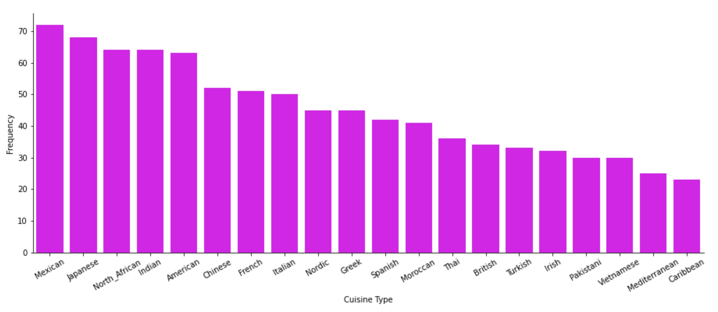
Overall Class Distribution

Slide 9
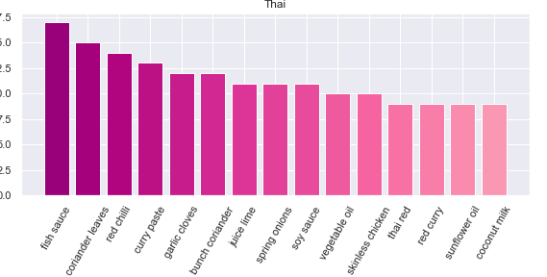
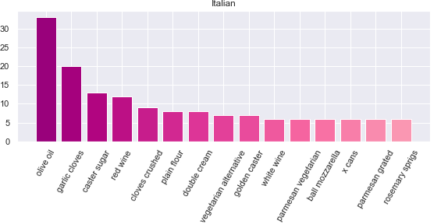
Some Interesting Finds distinguishable
Model may rely on specific key ingredients, depending on the cuisine:
High frequency → better classification
Thai Seem to stick to traditional ingredients
Fish sauce
coriander
Italian
Olive oil
parmesan cheese

Slide 10
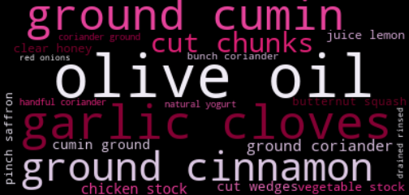
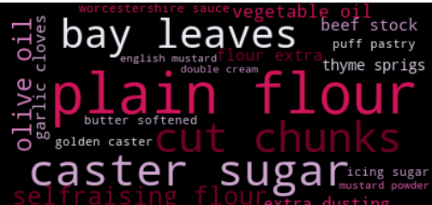
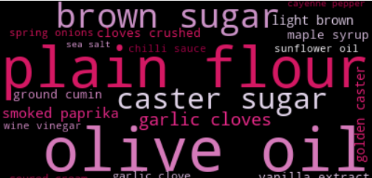
WordClouds non-distinguishable
Moroccan Cuisines
Cut chunks
Olive Oil
British Cuisines
Plain flour
Cut chunks
American Cuisines
Olive oil
Plain flour

Slide 11
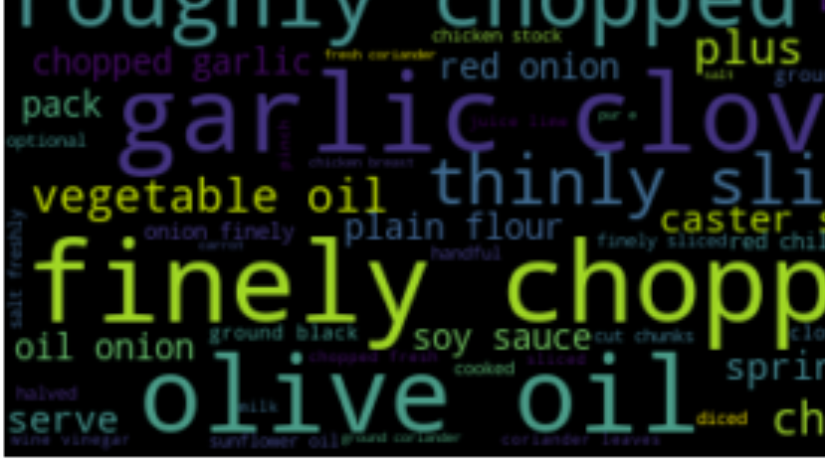

Methods
Natural Language Processing
Natural Language Processing Tool Kit
Cleaning done using:
Sci-Kit Learn
Regular Expression
Tokenization
Distinguish each word
Stop-word removal
NLTK
Common words like “and, you, I, or, etc.”
Custom
Common cooking measurements like “tsp, tbsp, cup, etc.”
Common meaningless words
Models
Target = Cuisine
Data = Ingredients
Random Forest
Naive Bayes
SVM*
Logistic Regression

Slide 12
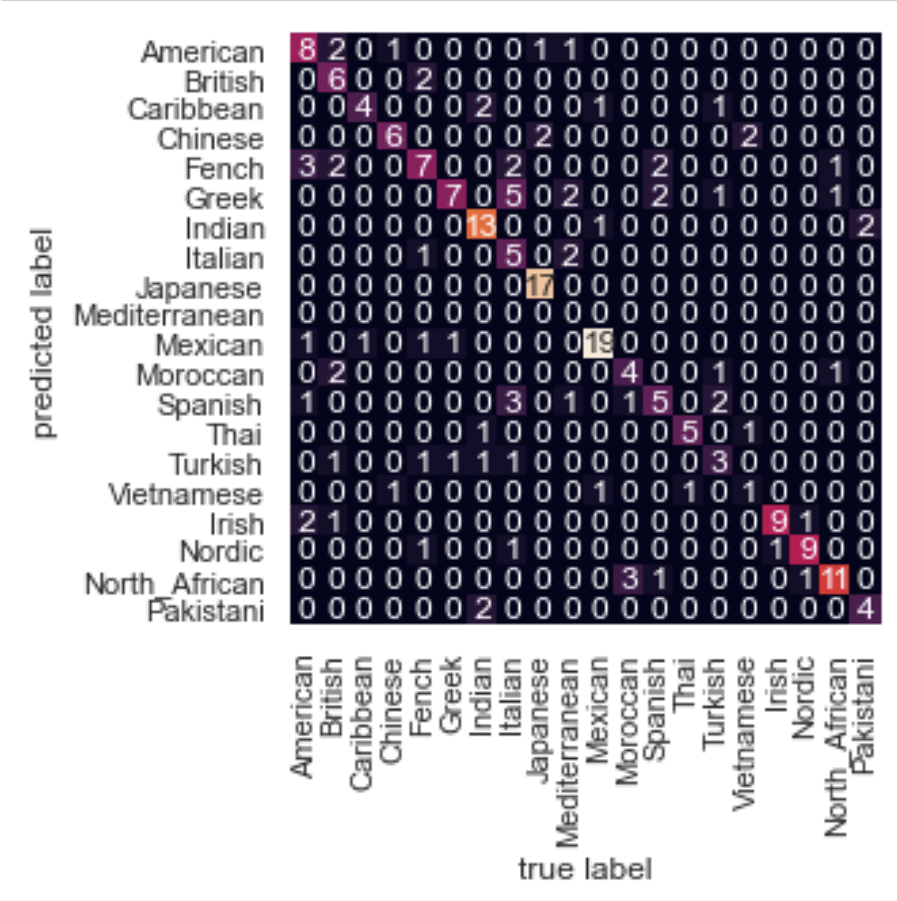
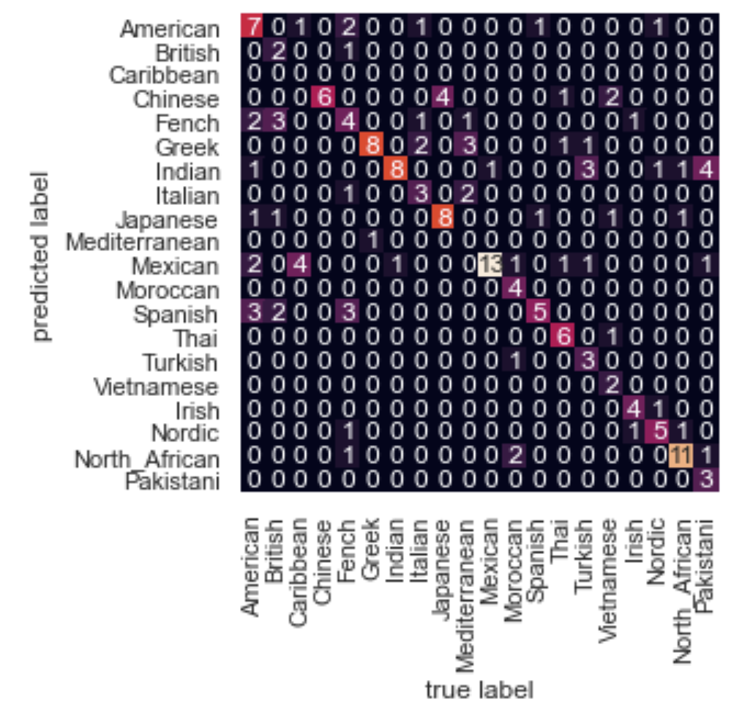
Results
Accuracy: 0.64
Quite a few misclassifications
Vietnamese as chin or mexi or thai
“lime juice” & “coriander”
Mediterranean as ital or gree
“olive oil”
Caribbean could not be classified
Data too small
Some classification hits (most abundant)
Japanese
Mexican
North African
SVM
Random Forest

Slide 13
Conclusion
Model would greatly benefit from Principal Component Analysis
Model struggled at classifying the less abundant cuisines
Give the model more vocabulary to pinpoint as a beacon from classification
Lemming produced a better model than stemming or other
Increased maximum iterations increases accuracy
Generate more meaningful features
Stemming may have produced less meaningful words
Reiterating through the data improves the model

Slide 14
Next Steps
EDA, More Data, EDA
Feature engineering
Common words
Patterns
Implementation of Grid Search to optimize parameters
Streamlit
Neural Networks
Implement Natural Language Generation with the use of Markovify and Markov Chain Models
generate app that can provide a cuisine recipe given an input of ingredients

Slide 15



Thank You!
LinkedIn: Ijeoma Akamnonu
GitHub: https://github.com/aamoeji04/Cuisine_Classification_Capstone
Email: inakamno11@gmail.com

